Slide 1
Step It Up
Ashwin Venkataraman
Ke Ding
Swati Karn
Vaishal Patel

Slide 2
AGENDA
Introduction
Technology/Software
Project Architecture
Main Functions
UI Interface
Verification

Slide 3
Objective
Develop an app which can keep track of a users’ moving pattern, report his/her activity level and make suggestions.

Slide 4
Introduction
A fitness app is an application that can be installed on an Android device which has at least API 19 and used anywhere to calibrate the steps walked or distance walked.
Some Apps in market
MyFitnessPal
Google Fit
Activity Tracker
FitNesse

Slide 5
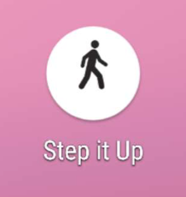
Introduction
This app can perform various functions such as track and store user’s step count or distance walked for a week. It can also count the steps walked isolated from the original counter for users interested in checking the distance walked separately.

Slide 6
Technology/Software Used
IDE:
Android Studio
Front end Coding Language:
Java
XML
Hardware Requirement:
Accelerometer
Database:
SQLite

Slide 7
Android Studio
Android Studio is the official integrated development environment(IDE) for Google's Android operating system, built on JetBrains' IntelliJ IDEA software and designed specifically for Android development.

Slide 8
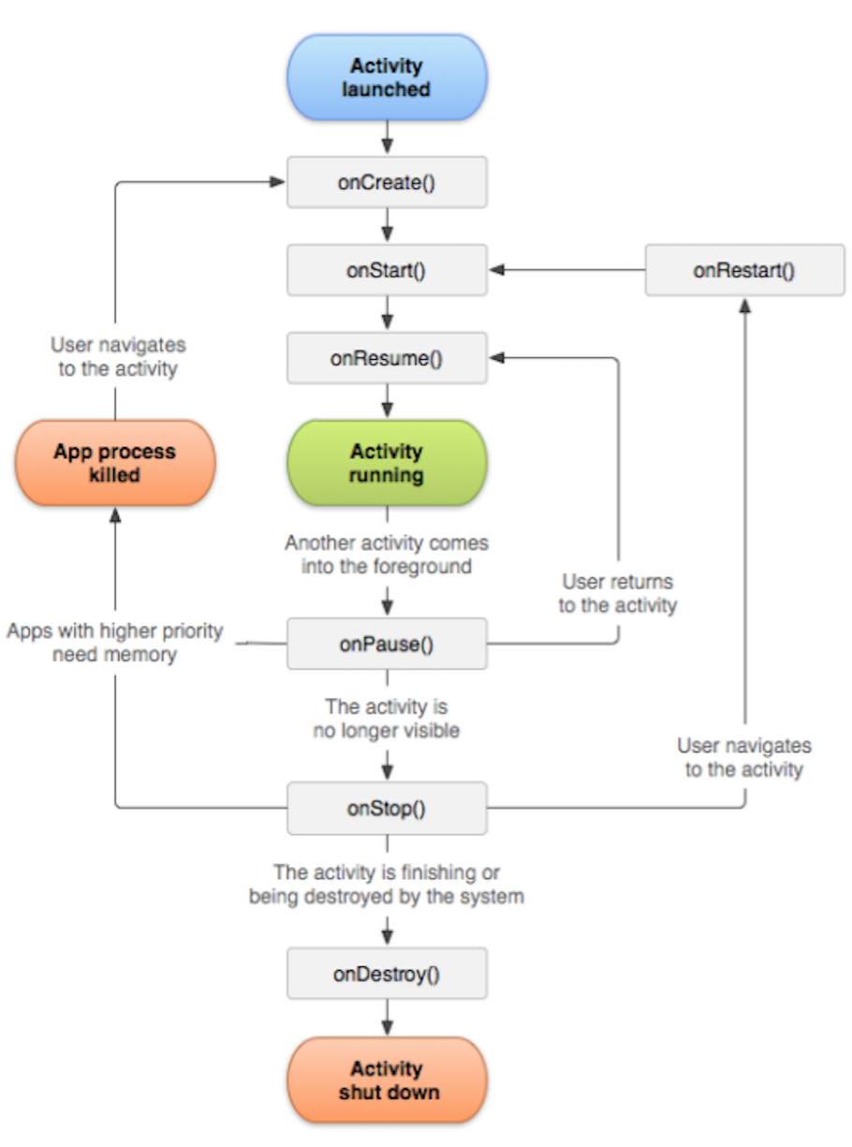
Android LifeCycle

Slide 9
Front end Coding Language:
XML-Extensible Markup Language (XML) is a markup language that defines a set of rules for encoding documents in a format that is both human-readable and machine-readable
JAVA-Java is a general-purpose computer-programming language that is concurrent, class-based, object-oriented, and specifically designed to have as few implementation dependencies as possible.
.

Slide 10
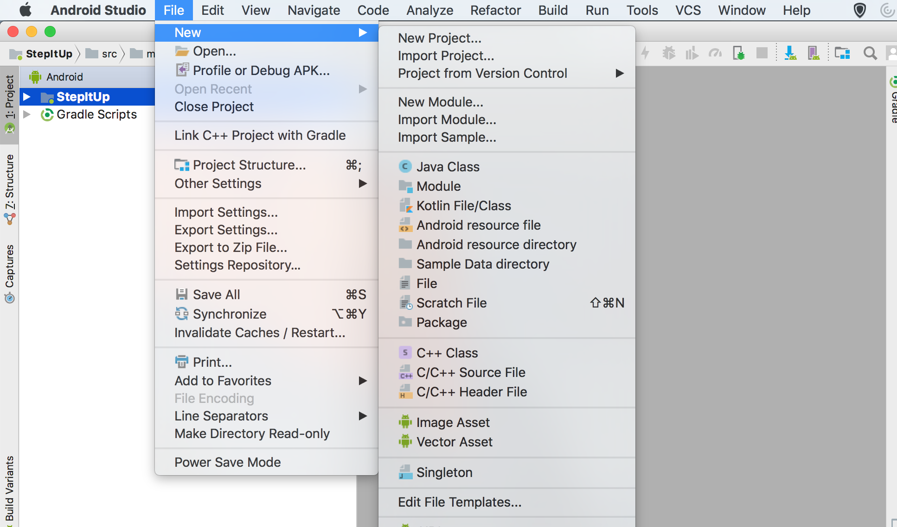
How to Create a Java Class in Android Studio

Slide 11
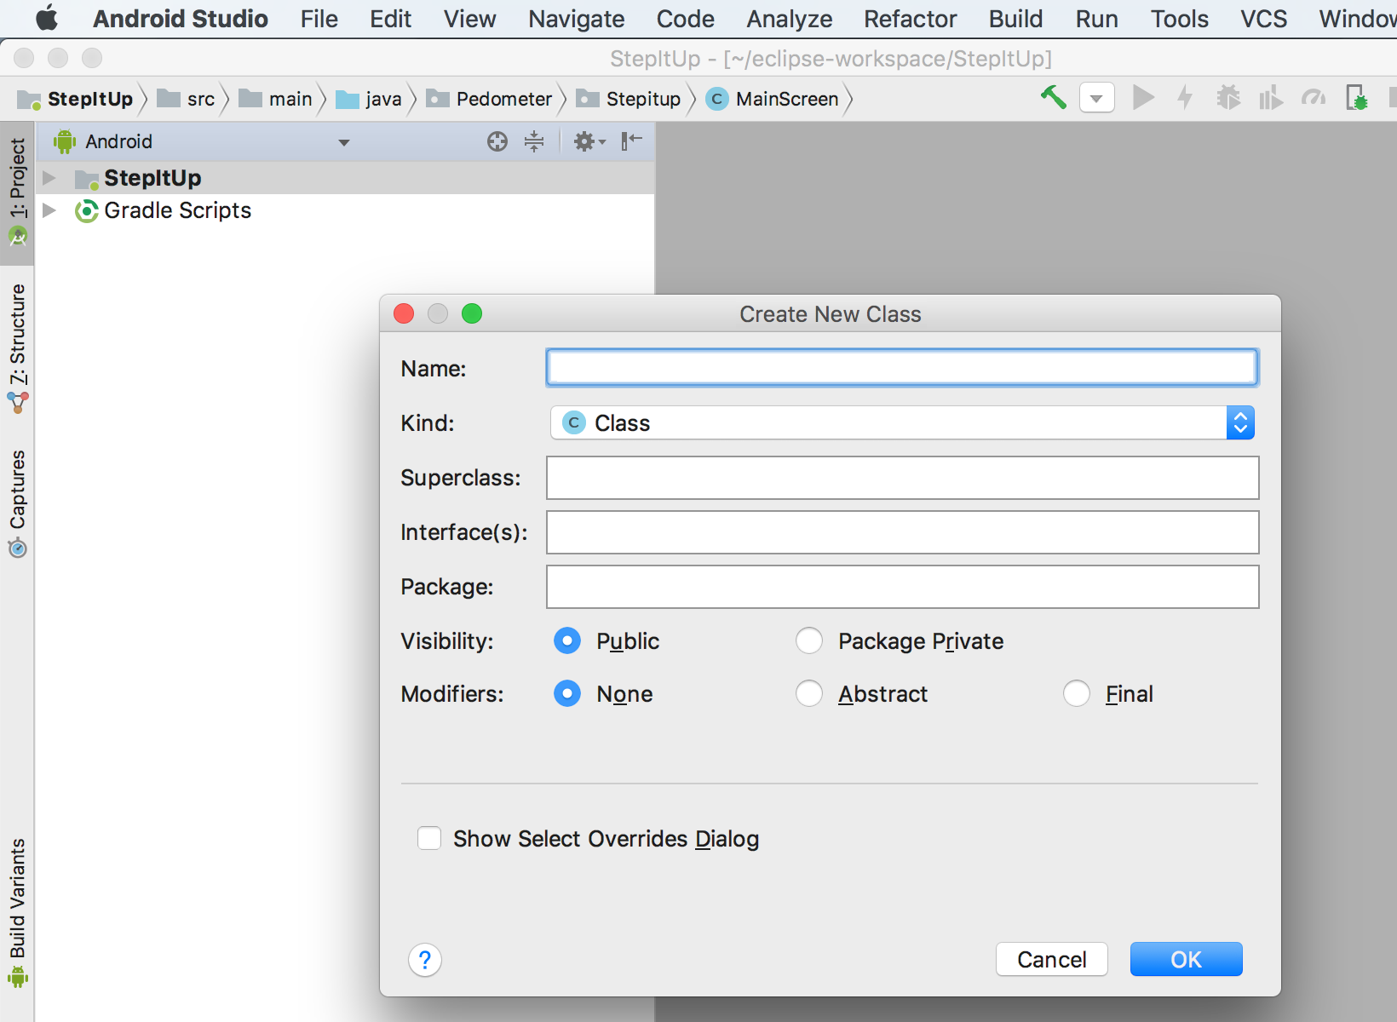

Slide 12
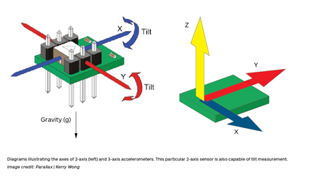
Accelerometer
An accelerometer is a device that measures proper acceleration. Proper acceleration, being the acceleration of a body in its own instantaneous rest frame.

Slide 13
SQLite
SQLite is a relational database management system contained in a C programming library. In contrast to many other database management systems, SQLite is not a client–server database engine. Rather, it is embedded into the end program.

Slide 14
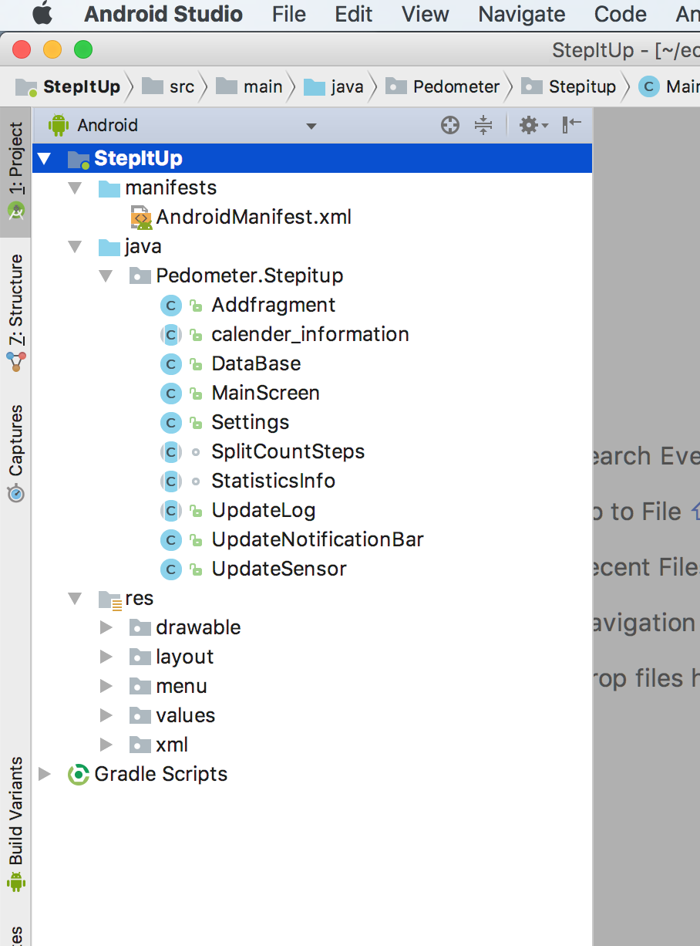
Framework
Package
Class
Res
Layout
Values
Xml
Gradle

Slide 15
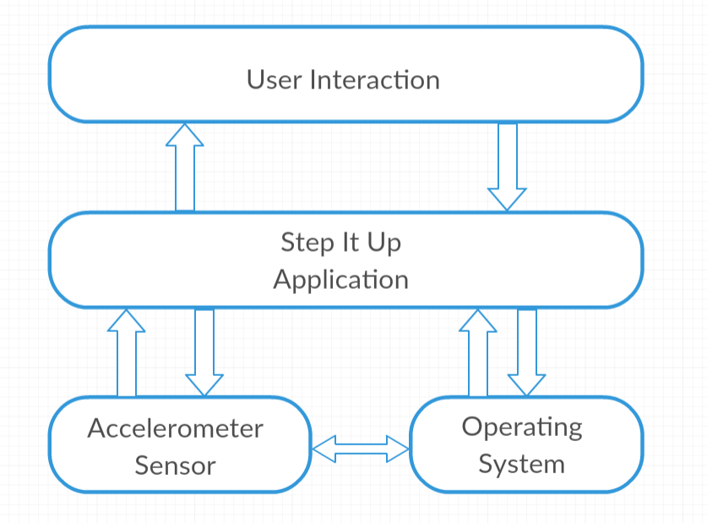
System Architecture

Slide 16
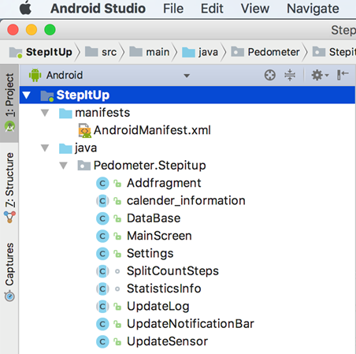
Main Functions (Classes)

Slide 17
Main Functions (Classes)
AddFragment:
Implement a fragment on mainscreen
Calender_Information:
Use abstract class ‘Calender’ to get the date information and precise one day interval
Database:
Create a SQLite database (use SQLiteOpenHelper) and store the daily step data into database
StatisticsInfo:
Create a pop up dialog (use ShowDialog) to show the statistics of average and total steps in the past week and month

Slide 18
Main Functions (Classes)
UpdateLog:
Update information to the LogCat in Android Studio
MainScreen:
Show a Pie chart with the dynamic step change as well as the average/total steps, and the percentage of goal completed. By one click, the Pie chart will switch the steps to distance.
Show a bar chart of step history. By one click, more detailed history stat data (contents in the function “History” mentioned below) will show in a pop up dialog.
UpdateNotification:
The Notification bar shows the Steps walked without opening the application. The user can Pause or Resume the counting of the Steps from the notification bar.

Slide 19
Sensor
Sensor
TYPE_STEP_DETECTOR: only single step
TYPE_STEP_COUNTER: accumulated step, need register to activate
SensorManger
Lets you access the device’s sensors
SensorEvent
Represent a sensor event, holds information such as the sensor’s type, time-stamp, accuracy and data
SensorEventListener
Used for receiving notifications from the SensorManager where there’s new sensor data
onSensorChanged(final SensorEvent event)
onAccuracyChanged(final Sensor sensor, int accuracy)

Slide 20
Main Functions (Classes)
UpdateSensor:
Register the sensor and call sensor to count steps.
Also included the split counter.
Settings:
Setting goals, step size (OnPreferenceClick) and whether to show notification bar (OnPreferenceChange).
SplitCountSteps:
Implement an individual step counter that can split count from the main pedometer, and show the data of this separate pedometer in a pop up dialog.

Slide 21
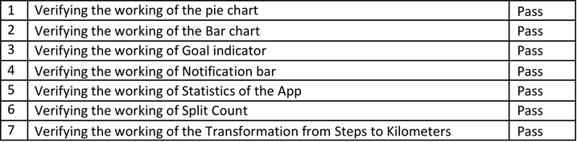
Verification
Design and Implementation
We used our requirement planning document and UI design document
Validation
We used pre-established test cases for validation

Slide 22
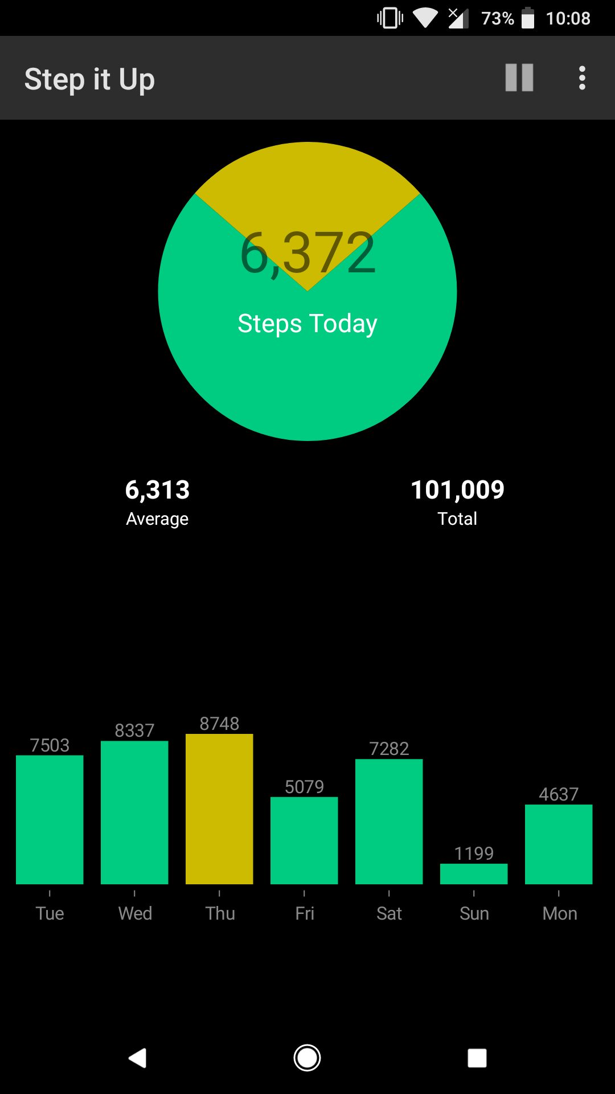
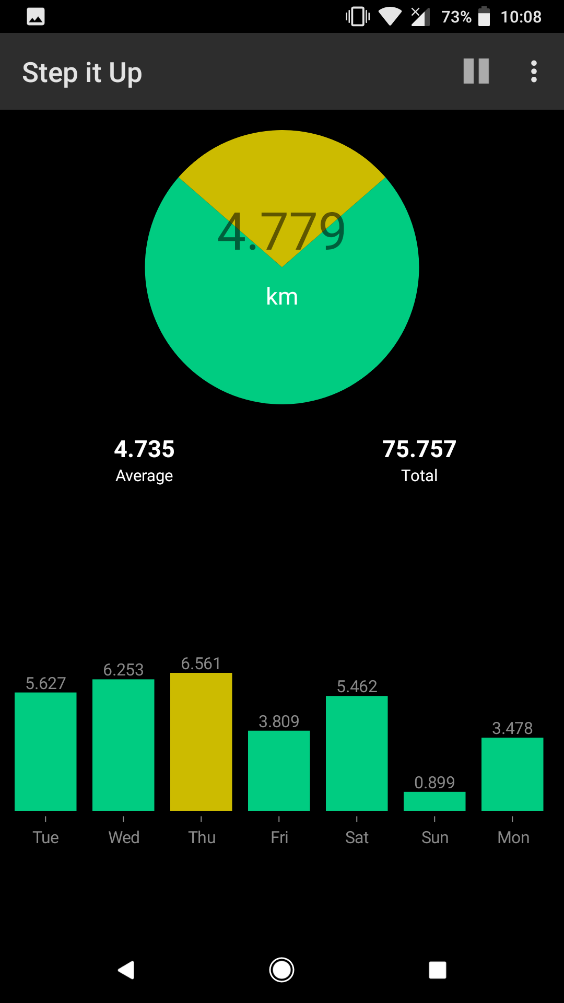
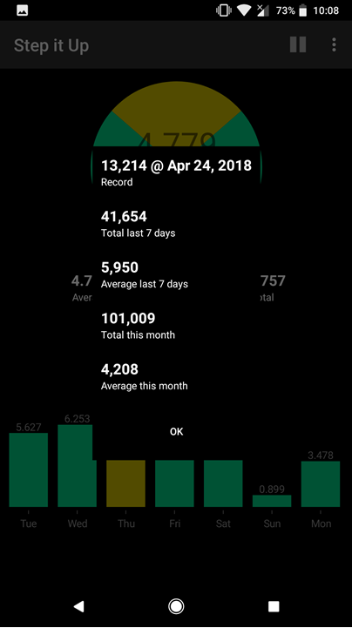
User’s Interface

Slide 23
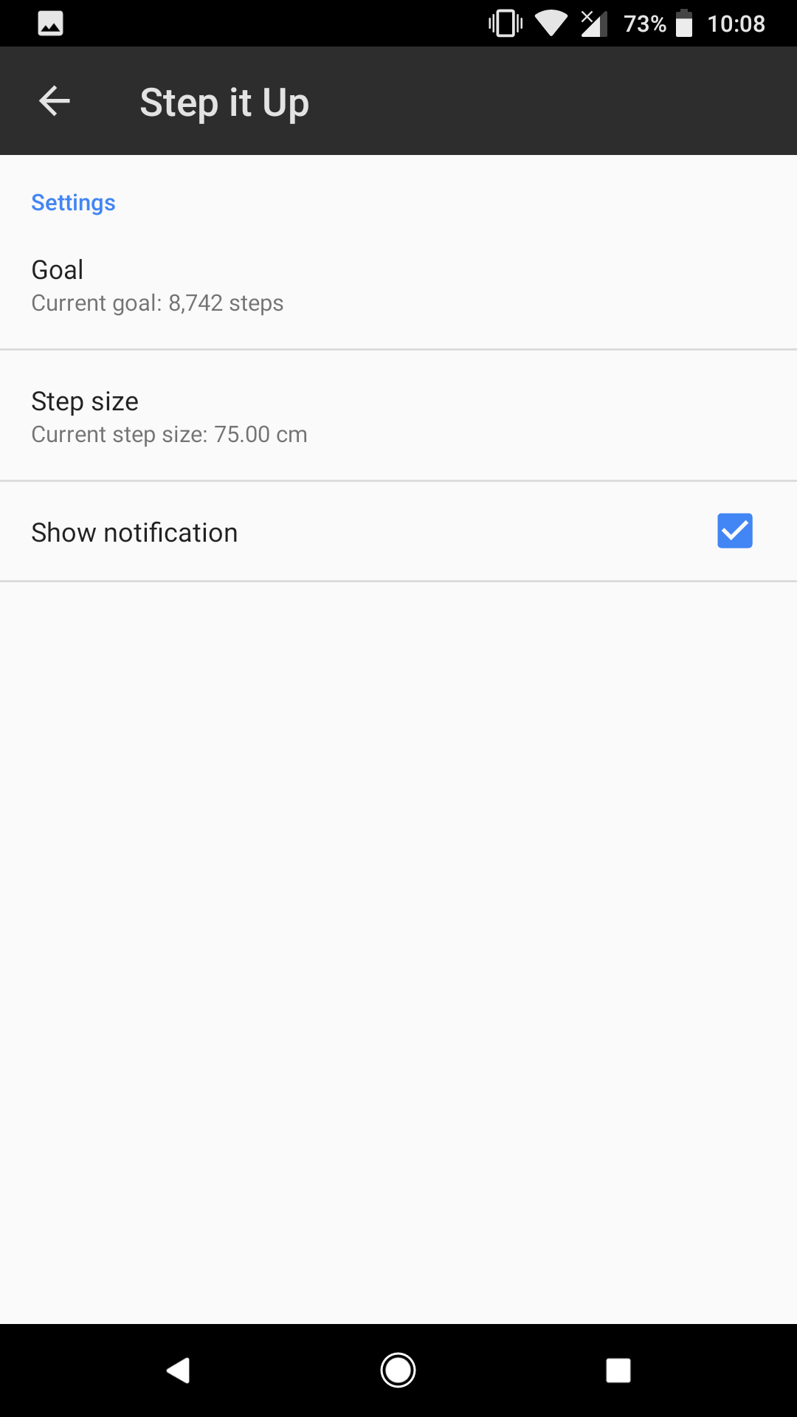
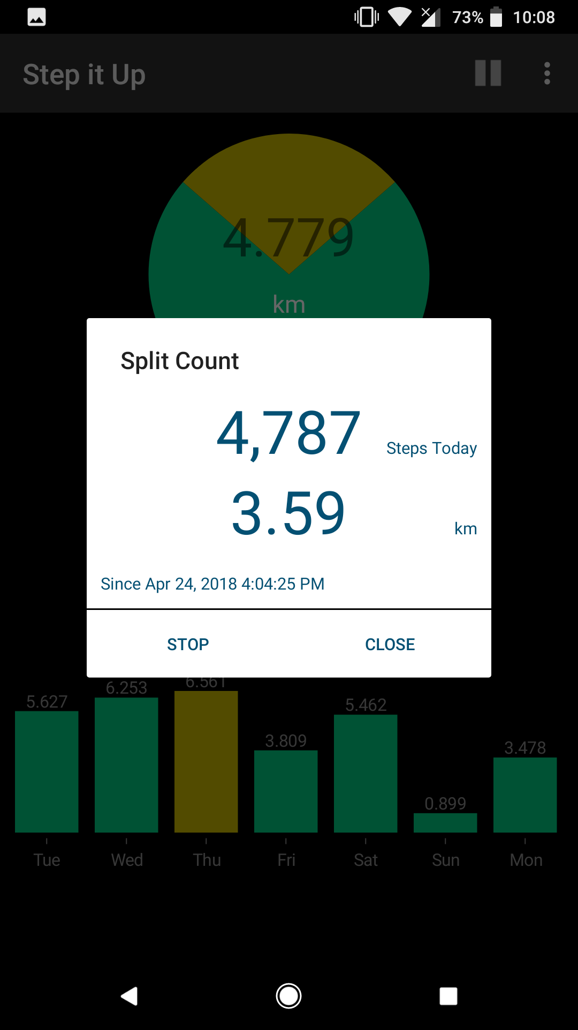
User’s Interface

Slide 24
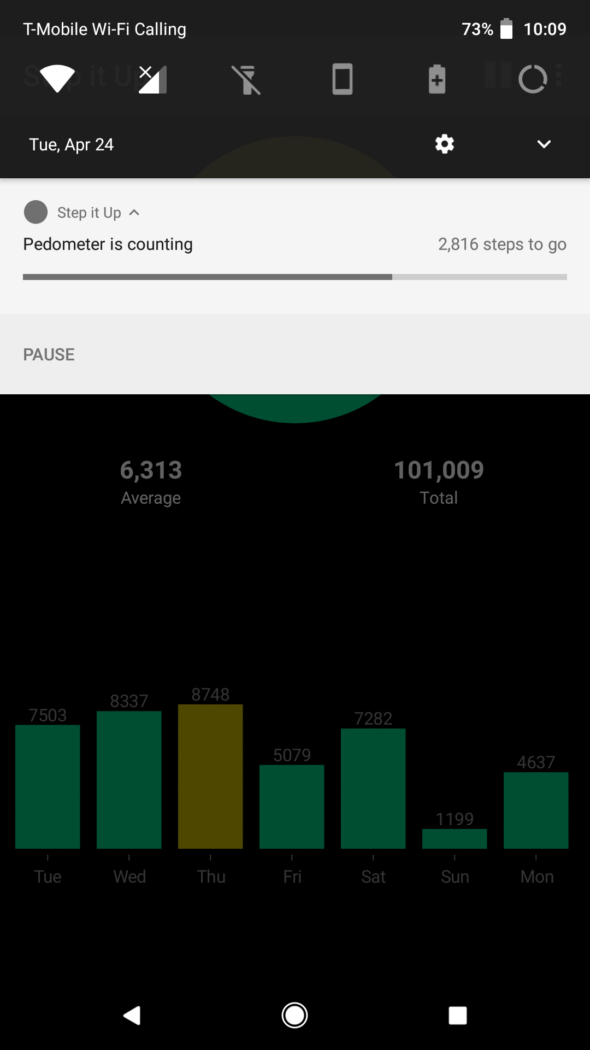

User’s Interface

Slide 25
Q&A

Slide 26
Thank You

